Slide 1
Lost & Found Database
Group 4
Jiaer Ji, Kundana Golla, Alexander Eischeid, Carter Adrias, Timothy Baldwin, Tina Wondimu
April 28 2025
INLS 523 Final Project

Slide 2
The
Problem
Students frequently lose personal items on campus
Challenges with tracking and retrieving lost items
Difficulty identifying owners and item locations
April 28 2025
INLS 523 Final Project
Notes:
Students losing items on campus is a common but serious issue. Without a proper system, it becomes difficult not just to find what was lost, but also to confirm who owns it and where it was misplaced. This leads to a lot of frustration and lost time for everyone involved.

Slide 3
The
Solution
Organized, structured storage of lost item information
Separate tables for items, locations, dates, and contacts
Includes details like item type, location, and photos
More reliable than traditional notebook systems
April 28 2025
INLS 523 Final Project
Notes:
A digital database offers a structured way to organize lost item reports. Each entity — like the item itself, where it was found, and the person who reported it — gets its own table, ensuring information is easy to retrieve and update. Compared to using a physical notebook, this approach is much more accurate and prevents common errors like missing or misfiled information.

Slide 4
The Importance of
Structured Data Management
Used widely across industries (e.g., businesses, libraries)
Prevents loss, confusion, and mismanagement
Enhances security and peace of mind for students
April 28 2025
INLS 523 Final Project
Notes:
Structured data management isn’t just important here — it’s critical in many fields. Businesses use it to track inventory; libraries use it to manage their book collections. In our context, structured records mean students can trust that if they lose something, it won’t disappear into a black hole. It saves time, reduces confusion, and provides reassurance.

Slide 5
User Stories
As a student, I want to quickly inquire about an item I've lost, including descriptions, images, and last-known locations, so I can improve my chances of recovering it promptly.
April 28 2025
INLS 523 Final Project
Notes:
Structured data management isn’t just important here — it’s critical in many fields. Businesses use it to track inventory; libraries use it to manage their book collections. In our context, structured records mean students can trust that if they lose something, it won’t disappear into a black hole. It saves time, reduces confusion, and provides reassurance.

Slide 6
User Stories
(cont.)
As a student or staff member who found an item, I want to easily report details and the location where the item was discovered, so the rightful owner can locate and claim their belongings swiftly.
April 28 2025
INLS 523 Final Project
Notes:
Structured data management isn’t just important here — it’s critical in many fields. Businesses use it to track inventory; libraries use it to manage their book collections. In our context, structured records mean students can trust that if they lose something, it won’t disappear into a black hole. It saves time, reduces confusion, and provides reassurance.

Slide 7
User Stories
(cont.)
As an administrator managing the lost and found, I want to generate regular reports of currently unclaimed items and their locations, so I can organize storage efficiently, facilitate easy retrieval, and periodically communicate updates to the campus community.
April 28 2025
INLS 523 Final Project
Notes:
Structured data management isn’t just important here — it’s critical in many fields. Businesses use it to track inventory; libraries use it to manage their book collections. In our context, structured records mean students can trust that if they lose something, it won’t disappear into a black hole. It saves time, reduces confusion, and provides reassurance.

Slide 8
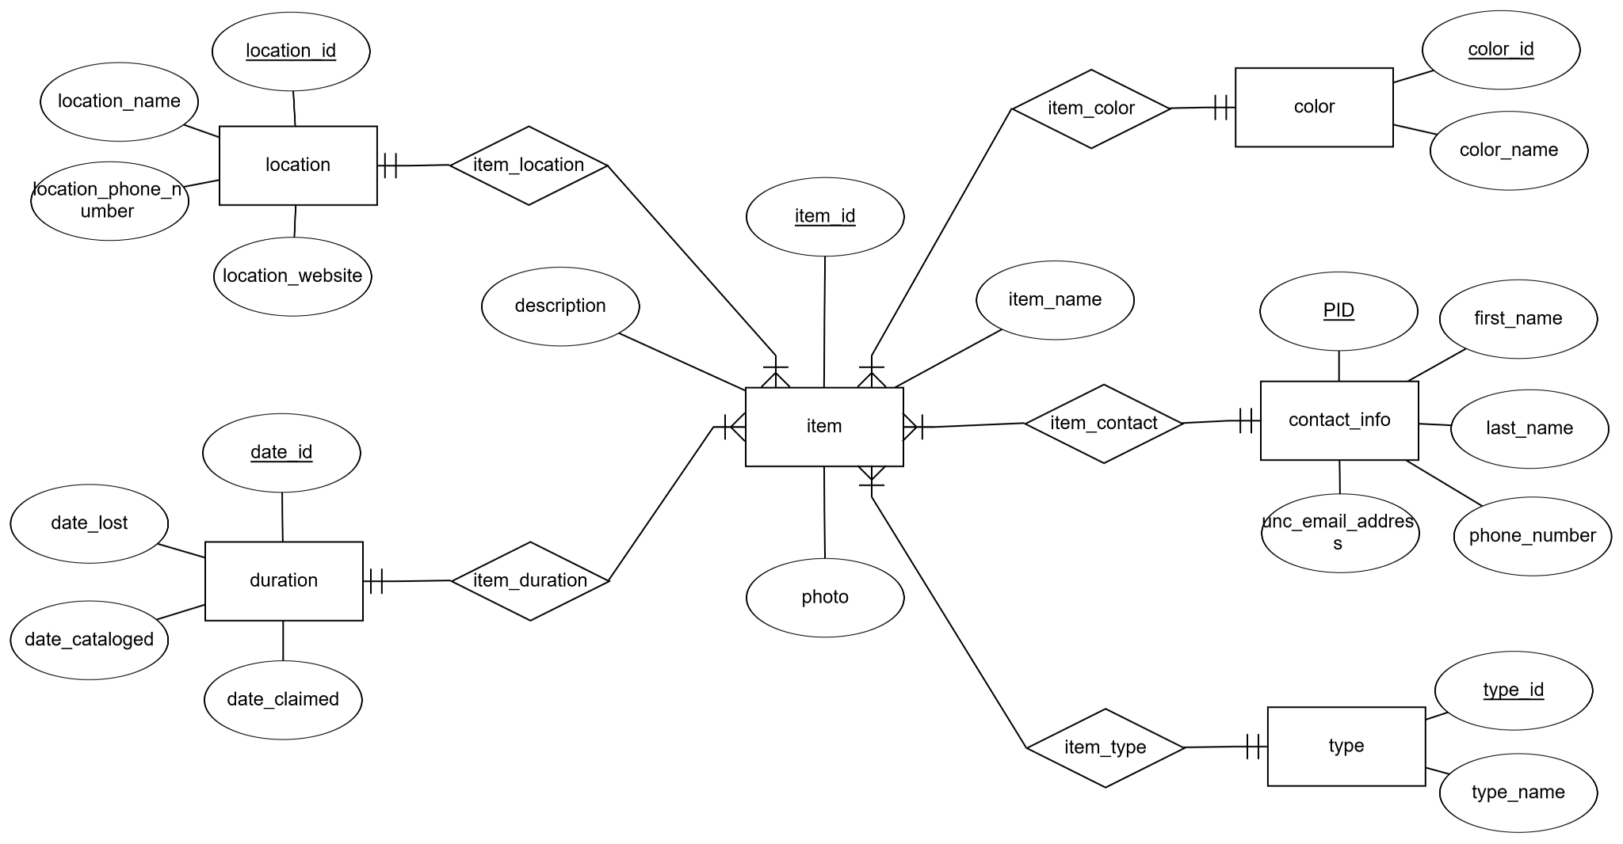
ERD Model
April 28 2025
INLS 523 Final Project

Slide 9
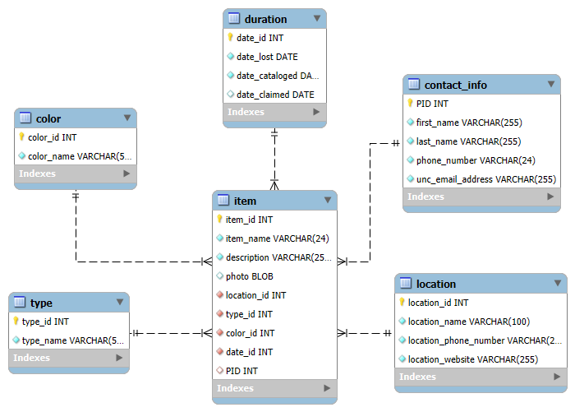
Logical Model
April 28 2025
INLS 523 Final Project

Slide 10
Relations
Item: item(item_id (PK), item_name, description, photo, location_id (FK), type_id (FK), color_id (FK), date_id (FK), PID (FK))
Location: location(location_id (PK), location_name, location_phone, location_website)
Type: type(type_id (PK), type_name)
Color: color(color_id (PK), color_name)
Duration: duration(date_id (PK), date_lost, date_cataloged, date_claimed)
Contact_info: contact_info(PID (PK), first_name, last_name, phone_number, unc_email_address)
April 28 2025
INLS 523 Final Project

Slide 11
Problem
Resolution
Replaced unorganized logbooks and spreadsheets commonly used in lost and found locations with one central database.
Normalized up to 3NF/BCNF to eliminate data duplicates and anomalies when updating the data.
Referential integrity made sure every item reported is linked to a valid location, type, color, and owner contact
April 28 2025
INLS 523 Final Project

Slide 12
Problem
Resolution
Design is scalable; any new locations or items can be added without having to redesign our database.
Database can be used for future interfaces such as a web browser.
Auto-increment IDs and indexed keys enables quick and easy lookups for anyone using the database
April 28 2025
INLS 523 Final Project

Slide 13
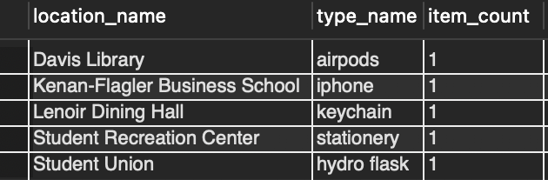
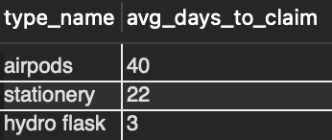
Database Reports
View 1: item_type_counts_by_location
Shows the most common item types at each location
View 2: avg_claim_time_by_type
Calculates average days from cataloging to claim by type
April 28 2025
INLS 523 Final Project

Slide 14
Conclusion
Challenges:
Each item having so much information associated with it made the repetitive task of accurately inputting data more difficult.
Coming up with queries, and creating the necessary code for the queries, was challenging at times.
Considering the simple scope of our project, we recognize that a real-life implementation of this database would require photo storage, strong privacy protection, and an intuitive UI.
April 28 2025
INLS 523 Final Project

Slide 15
Conclusion
Takeaways:
We have a greater understanding of the importance of user epics and stories in putting ourselves in a user’s shoes and considering their needs for a database.
If we were to approach this project differently, we would probably spend more time brainstorming each entity and its attributes. This would allow for an even more efficient and effective database.
April 28 2025
INLS 523 Final Project

Slide 16
Thank you!
April 28 2025
INLS 523 Final Project

